Slide 1
Edge Computing, Fog computing, and cloudlet. what the heck are they?
Sung-Ju Lee
School of Computing
KAIST

Slide 2
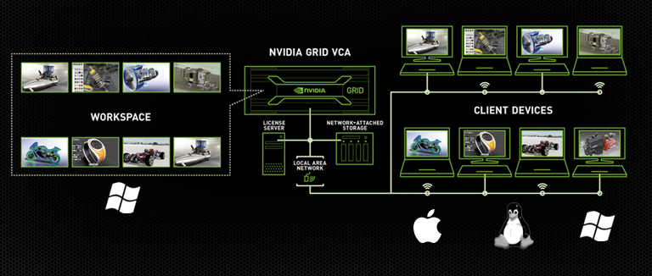
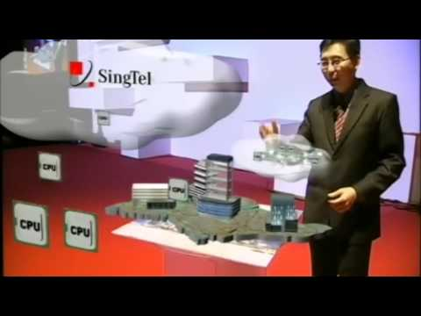
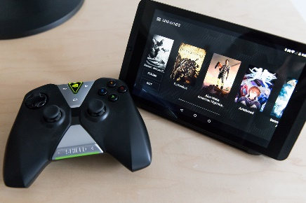
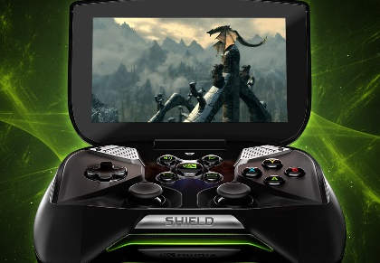
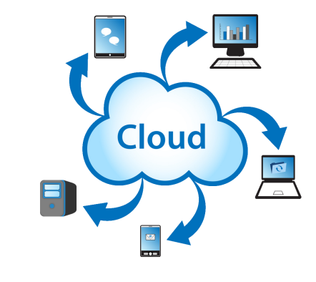
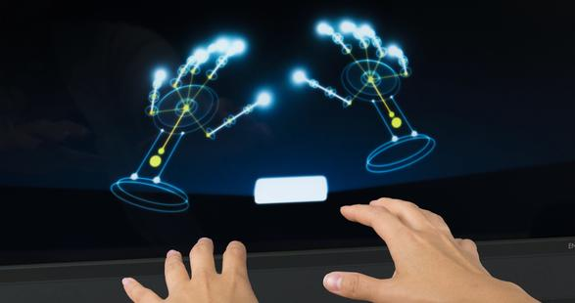
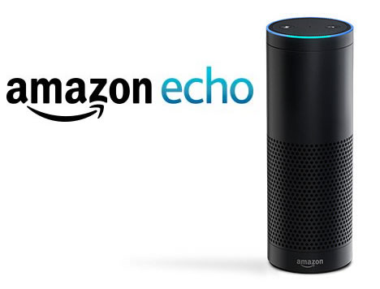
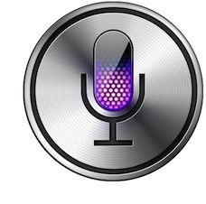
Augmented Reality SingTel i.luminate 2010 on SingTel's Cloud Computing Offerings
Cloud game streaming nvidia shield
Motion recognition
Voice recognition
Siri

Slide 3
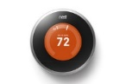
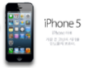
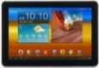
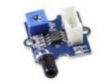
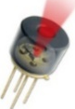
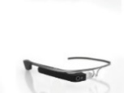
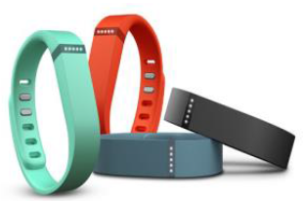
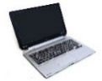
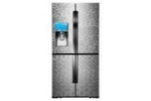
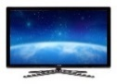
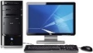
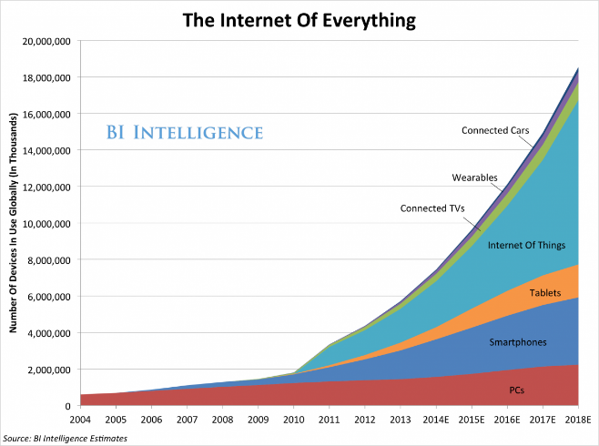
IoT
Various devices
Devices that have various network interfaces
Various applications
Growth of IoT devices
Large scale data
Traffic pattern: traffic between adjacent devices increase
Sensor device
Resource (CPU, storage)

Slide 4

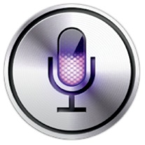

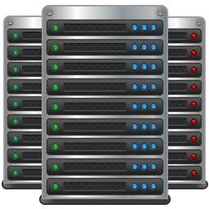


Cloud Computing
Contradiction between resource poor (battery, computing power) mobile devices and complex applications
Cloud Computing
Offloading local computations to remote execution
Reduced computation delay
Increased communication delay
Limited computing power

Slide 5
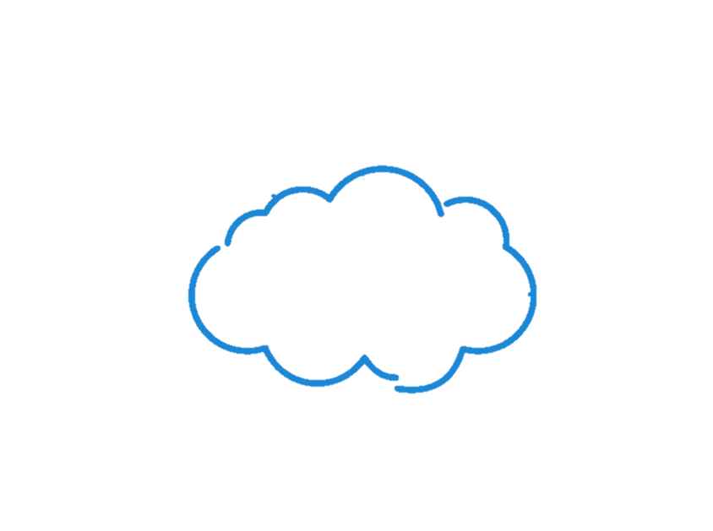





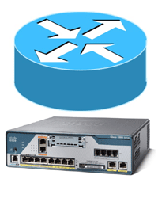
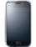
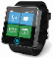
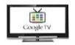
Trends
Various service
A great deal of application code is hosted in the so-called cloud
Various requirement
(interactive) Apps require super fast response time
Apps require intensive resource (e.g., storage, computing power, etc.)
IoT
The number of device increases
Traffic between adjacent devices increases
Central Cloud
: CPU
: Storage
Wide Area Network
…
…
Edge devices
Edge devices
Edge devices
Two-tier architecture

Slide 6
The limitations of Cloud Computing
Long WAN latencies are a fundamental obstacle
WAN delays in the critical path of user interaction can hurt usability
Traffic to central cloud increases
Computational & network overhead at central cloud increases
Central Cloud
: CPU
: Storage
Delay
Wide Area Network
…
…
Edge devices
Edge devices
Edge devices

Slide 7
The limitations of Cloud Computing
Network communication latency of clouding computing
Can be up to 400 ms
Many mobile apps are delay-sensitive
Performance
degrades!
Round trip cities | Max(ms) | Mean(ms) | Min(ms)
Berkeley-Canberra | 174.0 | 174.7 | 176.0
Berkeley-Troudheim | 197.0 | 197.0 | 197.0
Pittsburgh-Hong Kong | 217.0 | 223.1 | 393.0
Pittsburgh-Seatle | 83.0 | 83.9 | 84.0
Pittsburgh-Dublin | 115.0 | 115.7 | 116.0
Tong, Liang, Yong Li, and Wei Gao. "A Hierarchical Edge Cloud Architecture for Mobile Computing.“, IEEE INFOCOM 2016

Slide 8





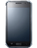
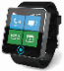
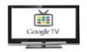
Edge Computing
Central Cloud
Small scale cloud servers at the edge
Moving app code and data from the main cloud to the fringes of networks
Reduce the network latency accessing data center
Support user mobility
…
Wide Area Network (WAN)
Edge Cloud
Edge Cloud
Edge Cloud
: CPU
: Storage
: CPU
: Storage
…
Edge device
Edge device
Edge device
Three-tier architecture

Slide 9
Edge Network Reference Model
1. Open Edge Computing (Cloudlet): http://elijah.cs.cmu.edu/
Led by CMU, supported by Intel, IBM, Google, AT&T, Huawei, Vodafone, etc.
Focusing on software system (API) standard and code offloading
2. Fog computing: http://fognetworks.org/ & http://www.openfogconsortium.org/
Leaded by Cisco & Princeton, supported by Intel, Microsoft
Focusing on processing large IoT data at the edge in soft real-time
3. Mobile Edge Computing (MEC) http://www.etsi.org/technologies-clusters/technologies/mobile-edge-computing
ETSI, supported by Nokia, IBM, Huawei
Focusing on APIs for 3rd parties (application developer, content provider) and exploiting radio access network (RAN) information

Slide 10
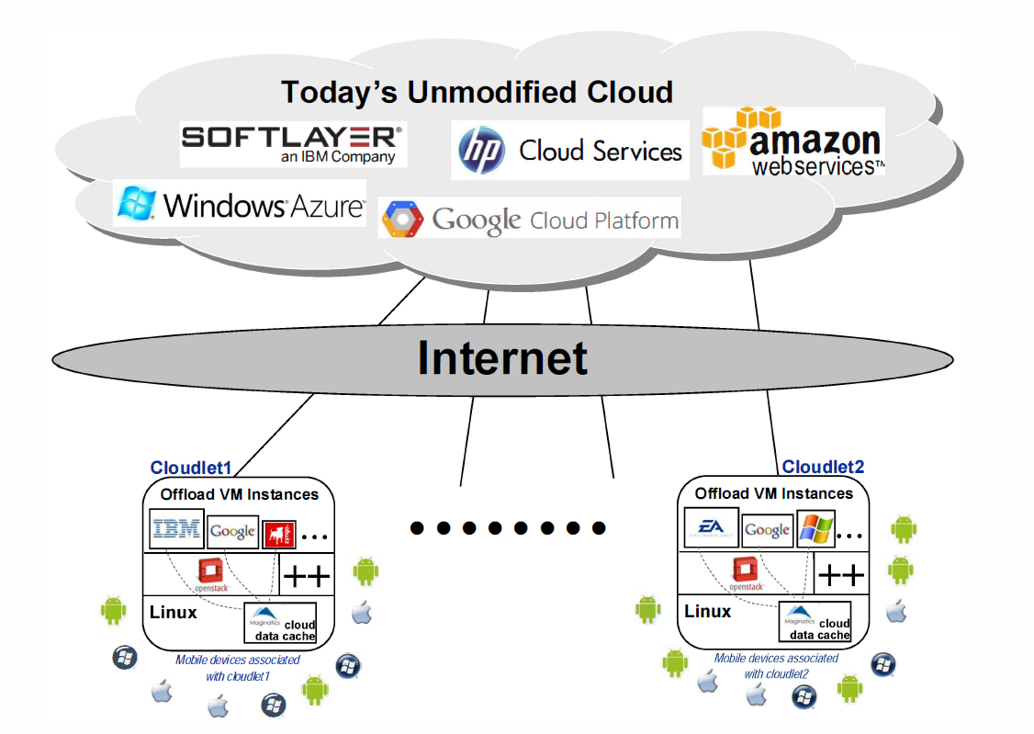
Cloudlet (CMU)
Resource poverty of a mobile device can be addressed by using a nearby resource rich cloudlet
The end-to-end response time of applications executing in the cloudlet needs to be fast (few milliseconds) and predictable
Cloudlets are decentralized and widely-dispersed Internet infrastructure
Focusing on resource intensive, but interactive mobile application
Satyanarayanan, M et al., "Cloudlets: at the Leading Edge of Mobile-Cloud Convergence“, MobiCASE 2014.

Slide 11
Cloudlet (CMU)
Resource poverty of a mobile device can be addressed by using a nearby resource rich cloudlet
The end-to-end response time of applications executing in the cloudlet needs to be fast (few milliseconds) and predictable
Cloudlets are decentralized and widely-dispersed Internet infrastructure
Focusing on resource intensive, but interactive mobile application
Satyanarayanan, M et al., "Cloudlets: at the Leading Edge of Mobile-Cloud Convergence“, MobiCASE 2014.

Slide 12
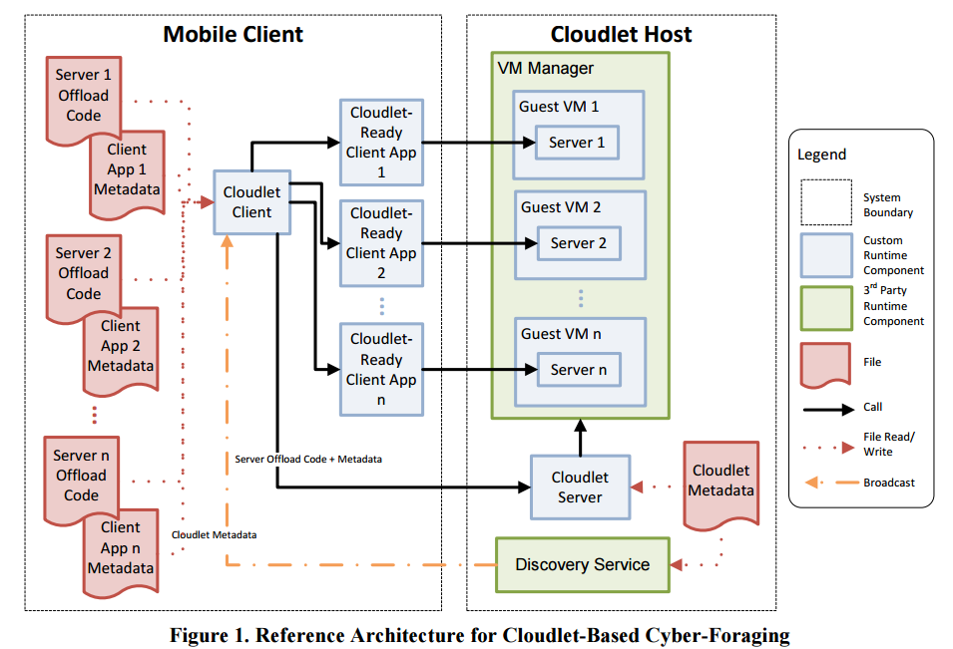
Cloudlet (CMU)
Architecture overview
Echeverria, et al., "On-Demand VM Provisioning for Cloudlet-Based Cyber-Foraging in Resource-Constrained Environments,“ MobiCASE 2014.

Slide 13
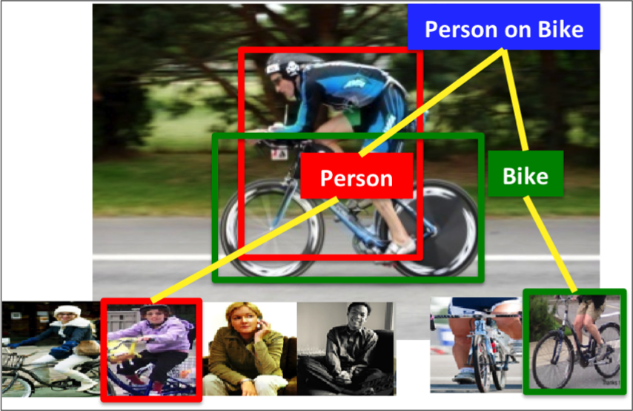
Cloudlet (CMU)
Use cases
Face recognition
Object recognition
Activity recognition
Augmented reality

Slide 14
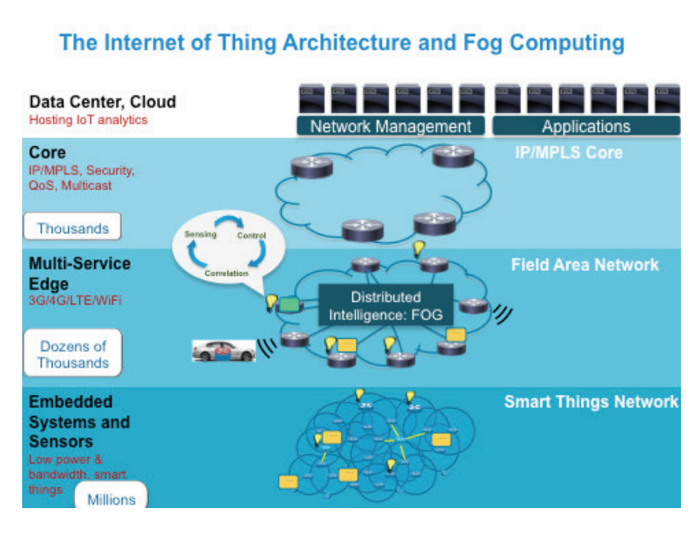
Fog computing (Princeton)
A highly virtualized platform that provides compute, storage, and networking services between end devices and traditional Cloud Computing Data Centers.
Fog node can be any device with computing, storage, and network connectivity
Focusing on time-sensitive and data-intensive IoT application & service
Flavio Bonomi, Rodolfo Milito, Jiang Zhu, Sateesh Addepalli., “Fog Computing and Its Role in the Internet of Things,“ ACM MCC 2012.

Slide 15
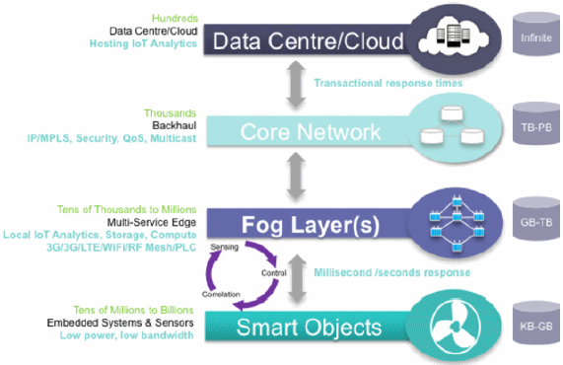
Fog computing (Princeton)
Architecture overview

Slide 16
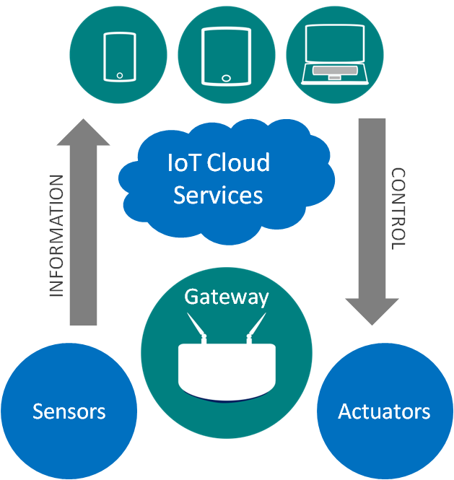
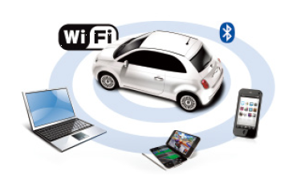
Fog computing (Princeton)
Use cases
Connected Vehicle (CV)
Smart Grid
Wireless Sensors and Actuators Network

Slide 17
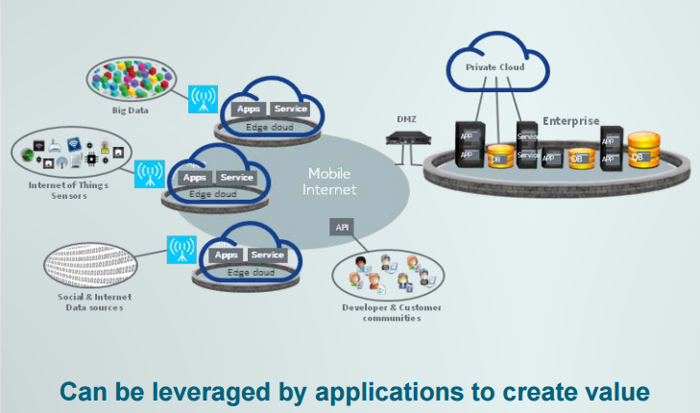
Mobile Edge Computing (ETSI)
Network architecture concept
Designed to be implemented at the cellular base stations
Enable cloud computing capabilities at the edge of the cellular network
Running application and performing processing task closer to the cellular customer
Enable flexible and rapid deployment of new application and services for customers
Cellular operators opens their radio access network (RAN) to authorized 3rd parties
Network congestion is reduced and perform better
“Mobile-Edge Computing – Introductory Technical White Paper”, September 2014.

Slide 18
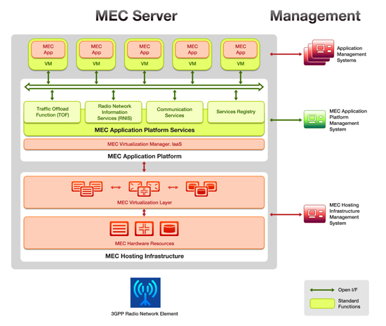
Mobile Edge Computing (ETSI)
Architecture overview

Slide 19
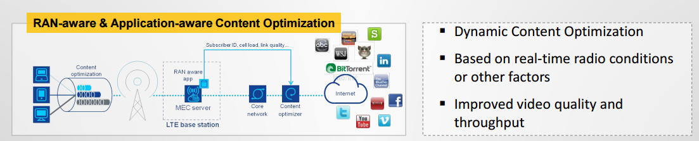
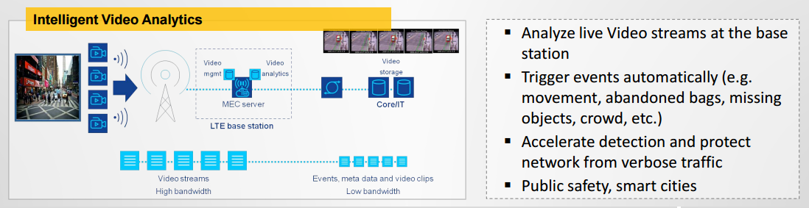
Mobile Edge Computing (ETSI)
Use cases
“Mobile-Edge Computing – Introductory Technical White Paper”, September 2014.

Slide 20
Common keywords
(mostly) 3-tier architecture: devices, edge, cloud
Low latency
Network capability
Computation capability
Better user QoS & QoE
Proximity

Slide 21
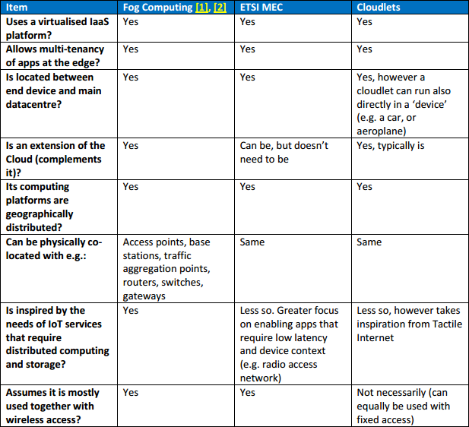
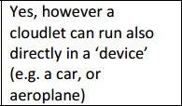
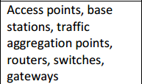
Comparison
“Fog Computing and the Internet of Things: Extend the Cloud to Where the Things Are”, Cisco White Paper, 2015.

Slide 22
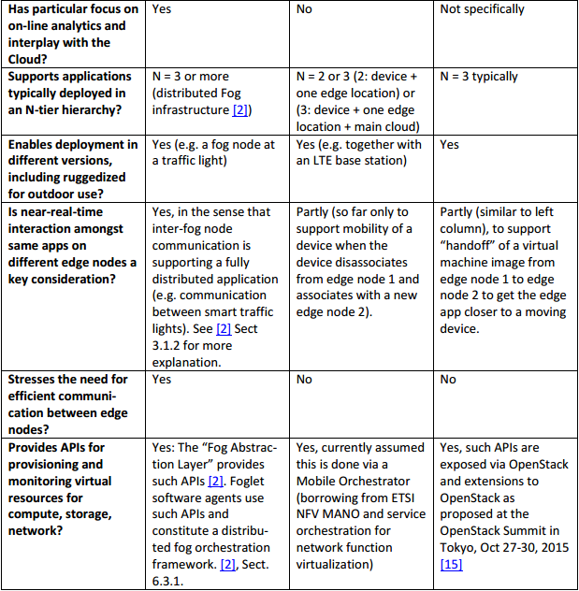
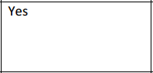
Comparison

Slide 23
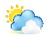


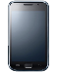
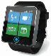
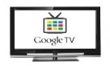
Research issues
Central Cloud
Interfacing between
edge cloud and main cloud
edge cloud and edge device
…
Wide Area Network(WAN)
Edge Cloud
Edge Cloud
: CPU
: CPU
: Storage
: Storage
…
Edge device
Edge device
Edge device

Slide 24
Research issues
Designing application deployable in a distributed cloud environment
Central Cloud
…
Wide Area Network(WAN)
Edge Cloud
Edge Cloud
: CPU
: CPU
: Storage
: Storage
…
Edge device
Edge device
Edge device

Slide 25
Research issues
Possible operational modes
Who would operate end-to-end applications
Which part of the application is hosted in the cloud, and which other parts are hosted in the edge?
Central Cloud
…
Wide Area Network(WAN)
Edge Cloud
Edge Cloud
: CPU
: CPU
: Storage
: Storage
…
Edge device
Edge device
Edge device

Slide 26
Research issues
How to allocate the job on edge cloud
Capacity of edge cloud is limited
Hierarchical architecture can alleviate performance degradation due to peak load on edge cloud
Tong, Liang, Yong Li, and Wei Gao. "A Hierarchical Edge Cloud Architecture for Mobile Computing.“, IEEE INFOCOM 2016

Slide 27
References
[1] Flavio Bonomi, Rodolfo Milito, Jiang Zhu, Sateesh Addepalli., “Fog Computing and Its Role in the Internet of Things,“ ACM MCC 2012.
[2] Guenter I. Klas, “Fog computing and Mobile Edge Cloud Gain Momentum Open Fog Consortium, ETSI MEC and Cloudlets”, Nov 22, 2015.
[3] “Fog Computing and the Internet of Things: Extend the Cloud to Where the Things Are”, Cisco White Paper, 2015.
[4] Satyanarayana. M et al., “Cloudlets: at the Leading Edge of Mobile-Cloud Convergence”, MobiCASE 2014.
[5] “Mobile-Edge Computing – Introductory Technical White Paper”, September 2014
[6] Tong, Liang, Yong Li, and Wei Gao. "A Hierarchical Edge Cloud Architecture for Mobile Computing.“, IEEE INFOCOM 2016

Slide 28
References
[6] Echeverria, et al., "On-Demand VM Provisioning for Cloudlet-Based Cyber-Foraging in Resource-Constrained Environments,“ MobiCASE 2014.
[7] Satyanarayanan, M et al., "Cloudlets: at the Leading Edge of Mobile-Cloud Convergence“, MobiCASE 2014.
The First IEEE/ACM Symposium on Edge Computing: http://conferences.computer.org/sec/

